Slide 1
WELCOME TO
WOMEN’S APPAREL
Group Member :
John Carl Porcopio
Alfonso Movida
Renz Magdaraog
Houard Datay
Jonel Dayapera

Slide 2
W EBSITE VERSION
Discover the latest trends in women's fashion — from everyday wear to elegant styles. Explore our wide selection of clothing, accessories, and footwear designed to make every woman feel confident, comfortable, and stylish.
CLICK HERE
CLICK HERE

Slide 3
A D M I N PA N E L
A D M I N PA N E L

Slide 4
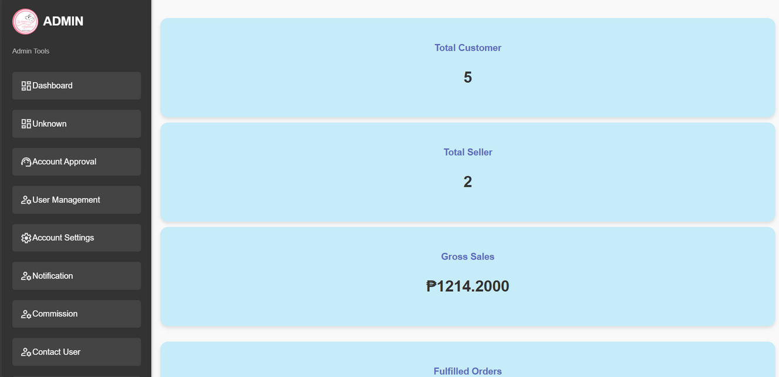
DASHBOARD
The dashboard shows key metrics: Total Customers reflects the number of buyers, Total Sellers shows how many vendors are active, and Total Sales Gross represents the total income from all sales before deductions. These figures help assess the platform’s user base, vendor participation, and overall financial performance.

Slide 5
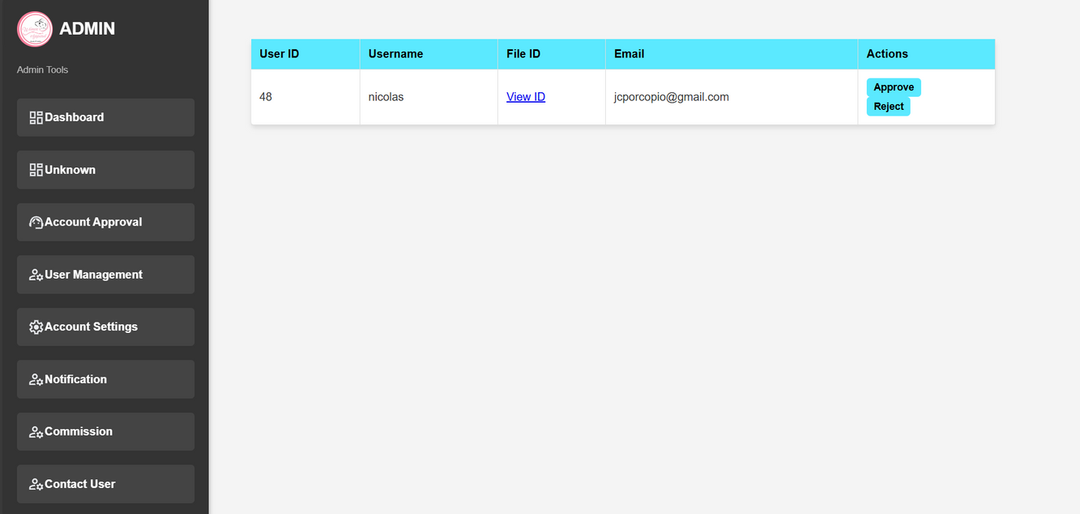
ACCOUNT APPROVAL
The Account Approval Dashboard displays key user details for managing access. It includes the User ID, Username, Email, and File ID for document verification. The Action column allows admins to approve or reject user accounts, ensuring secure and organized account management.

Slide 6
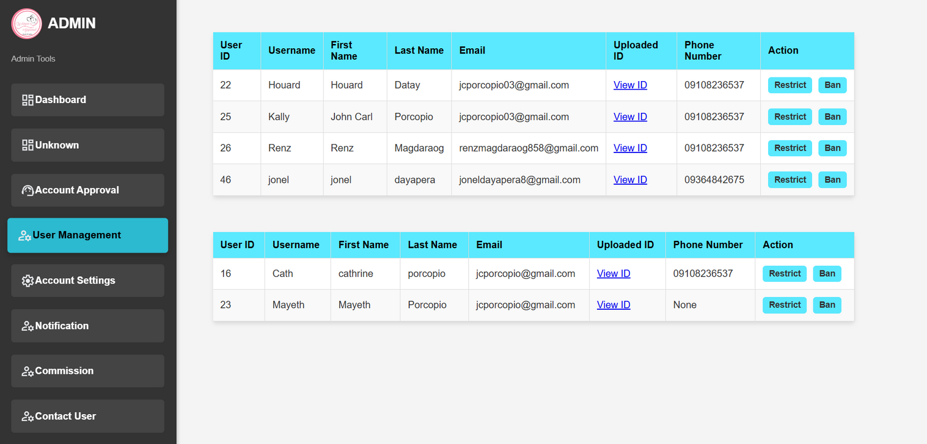
USER MANAGEMENT
The User Management provides an overview of all registered users. It includes key details such as User ID, First Name, Last Name, Email, Phone Number, and Uploaded ID for identity verification. The Action column allows admins to manage user accounts—such as editing, approving, or removing users—ensuring efficient and secure user administration.

Slide 7
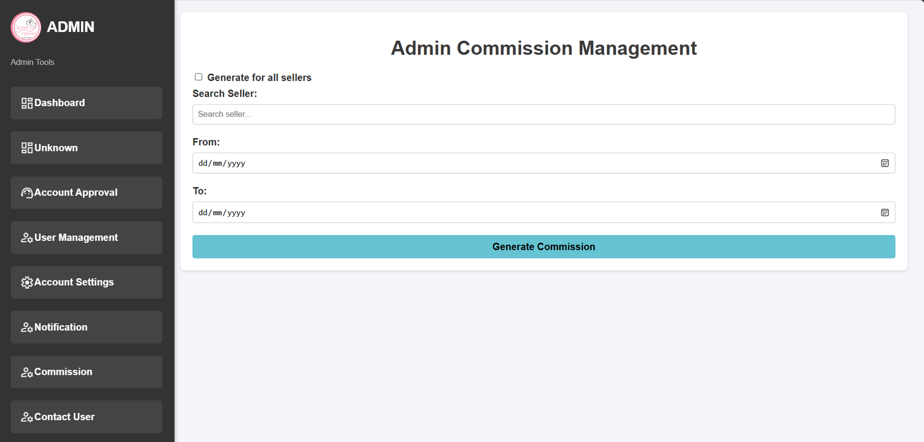
ADMIN COMMISION
The Admin Commission Management Dashboard allows administrators to track and manage earnings from seller transactions. It includes a Search Seller function to locate specific vendors and From-To date filters to view commissions earned within a selected timeframe. This helps ensure accurate monitoring of admin earnings and seller performance.

Slide 8
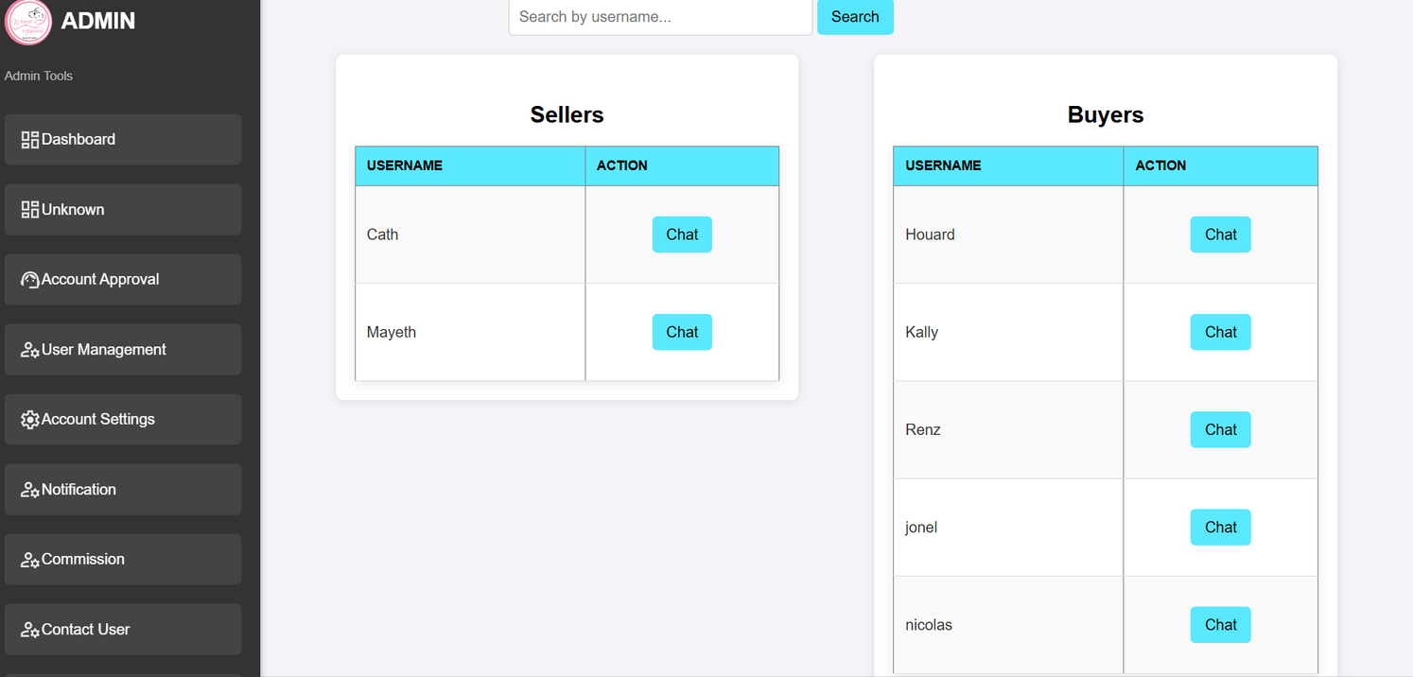
CONTACT SELLER
The Contact Seller helps track communication between users and sellers. It displays the Seller and User involved in the interaction, the Buyer Username, and provides an Action column for admin controlsuch as viewing messages, managing disputes, or removing conversations. This feature ensures smooth and secure communication within the platform.

Slide 9
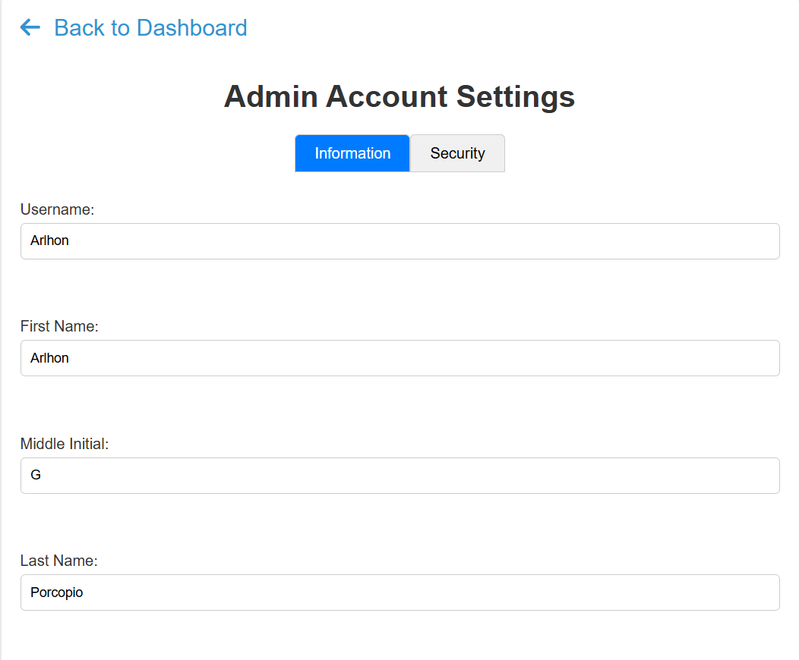
ACCOUNT SETTING
The Account Setting allows users or admins to view and update basic profile information. It includes fields such as Username, First Name, Middle Name, and Last Name to ensure accurate and personalized account details for each user.

Slide 10
B U Y E R PA N E L
B U Y E R PA N E L

Slide 11

HOMEPAGE
The Homepage serves as the main entry point of the platform. It includes a Search feature for users to quickly find products or services, and a Cart section where selected items for purchase are stored. These features help users navigate, shop, and manage their orders with ease.

Slide 12
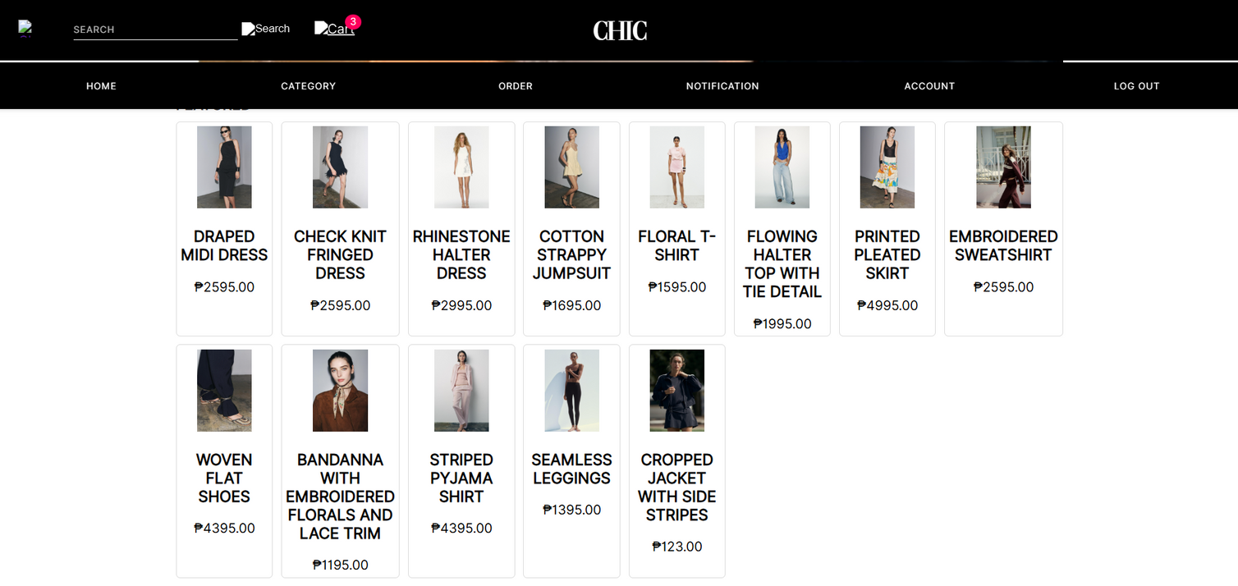
CATEGORY
The Category groups products into specific types for easy browsing. The Product Name identifies each item clearly, while the Price displays the cost of the product. Together, these details help users find and evaluate products quickly.

Slide 13
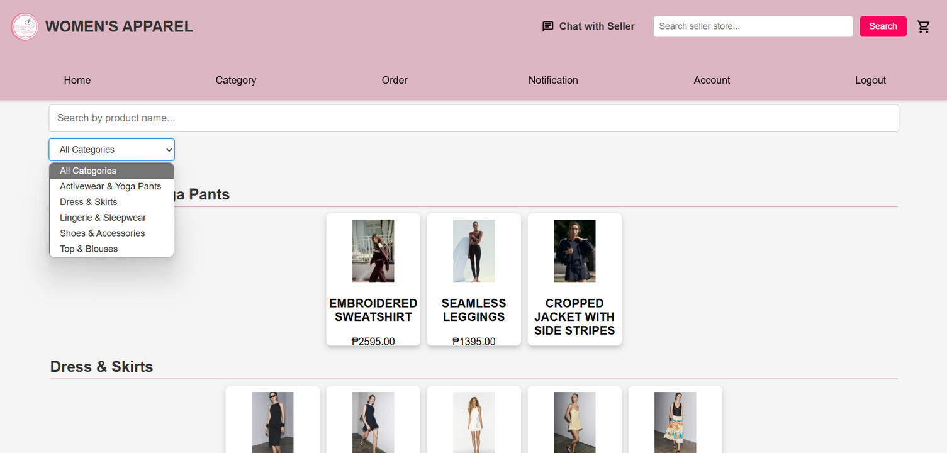
ORDER
The Order section lists all customer purchases. It includes the Product Name to identify the items ordered and the Price showing the cost of each product. The Filter option helps sort or narrow down orders based on criteria like date, price, or status for easier management.

Slide 14
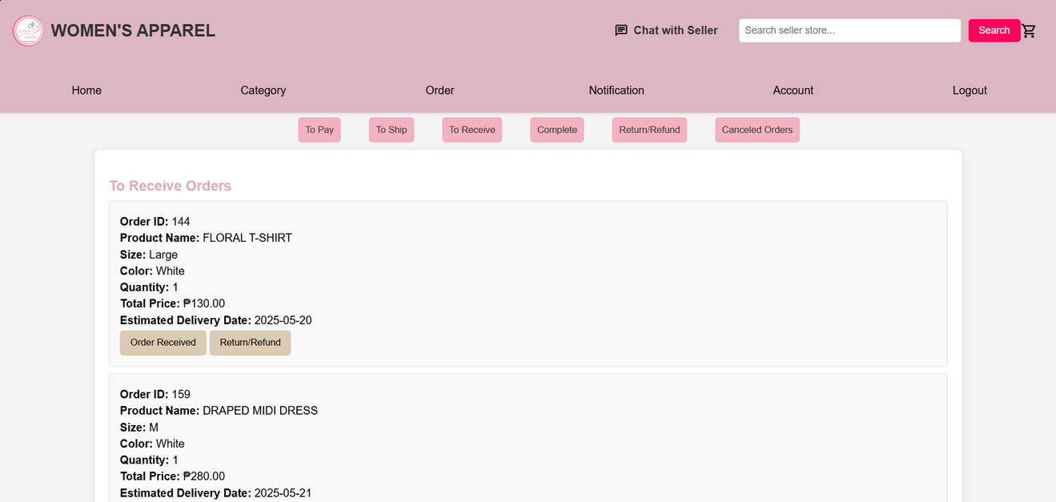
STATUS ORDER
Status Order tracks the progress of customer purchases.
To Pay: Orders awaiting payment from the buyer.
To Ship: Paid orders that sellers need to send out.
To Receive: Orders that have been shipped and are waiting for the buyer to receive them.
Complete: Orders successfully delivered and finalized.
Refund: Orders for which refunds are being processed.
Cancel Order: Orders that have been canceled by the buyer or seller.

Slide 15
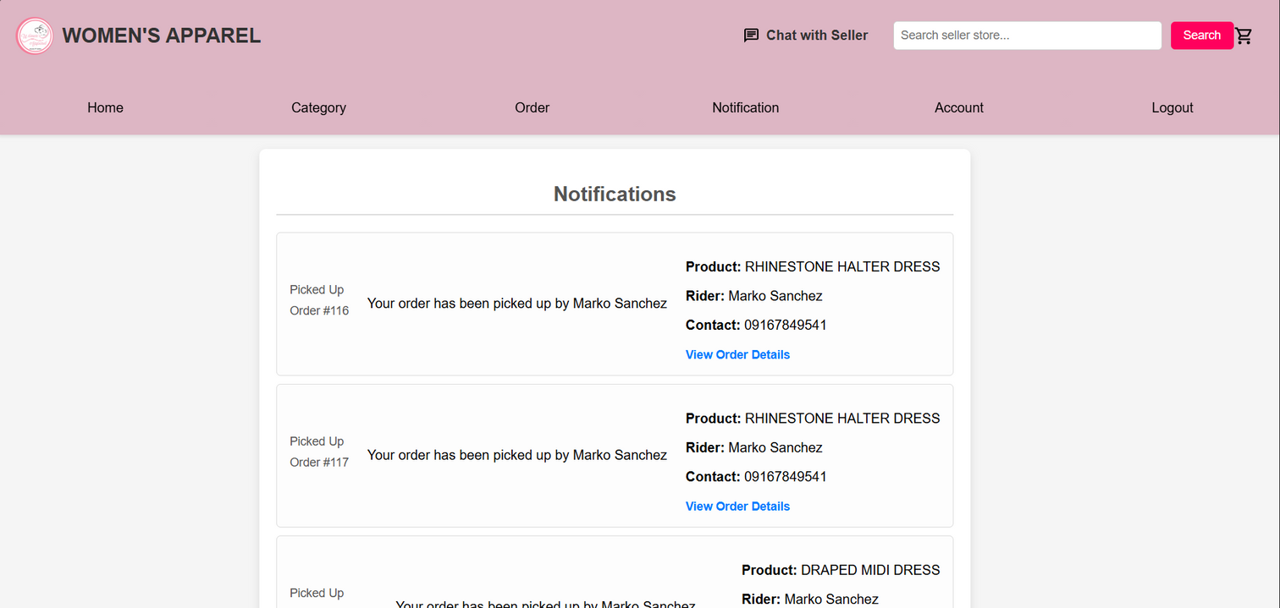
NOTIFICATIONS
Notifications keep users updated on important events, while the Product section provides detailed information about items for sale. The Rider handles delivery, ensuring orders reach customers on time. Contact information allows users to get support quickly. The View Order Detail feature gives users full insight into their purchases, making the whole shopping and delivery process smooth and transparent.

Slide 16
NOTIFICATIONS
Notifications keep users updated on important events, while the Product section provides detailed information about items for sale. The Rider handles delivery, ensuring orders reach customers on time. Contact information allows users to get support quickly. The View Order Detail feature gives users full insight into their purchases, making the whole shopping and delivery process smooth and transparent.

Slide 17
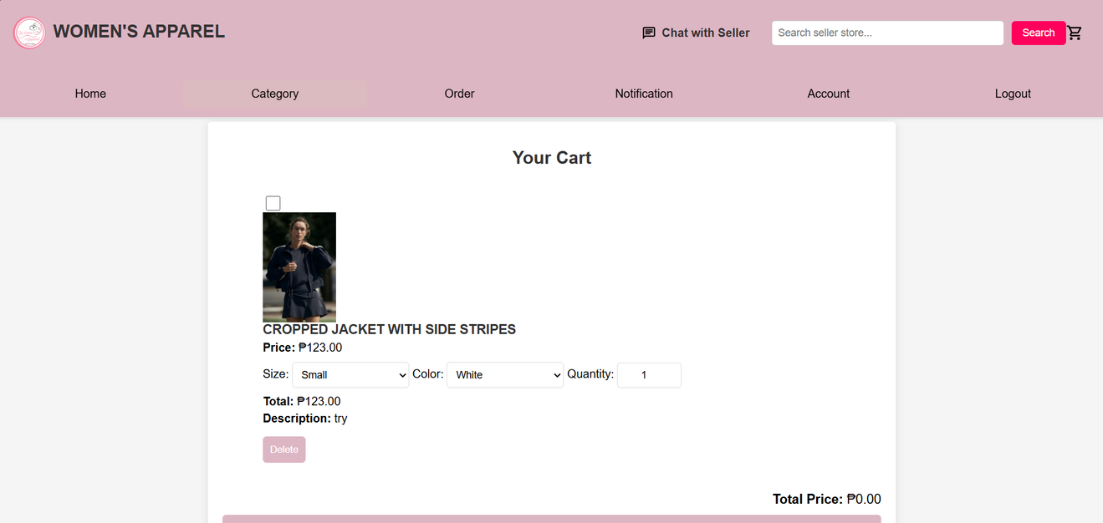
CART
The Cart is where users store products they intend to buy. Each item in the cart displays the Product Name to clearly identify it. The Price shows the cost of a single unit, while Size indicates the specific variant or measurement of the product, such as clothing size. The Total Price calculates the overall cost for the quantity selected. A brief Description provides additional details about the product to remind users what they are purchasing. Lastly, the Delete option allows users to remove unwanted items from their cart, giving them control over their selections before checkout.

Slide 18
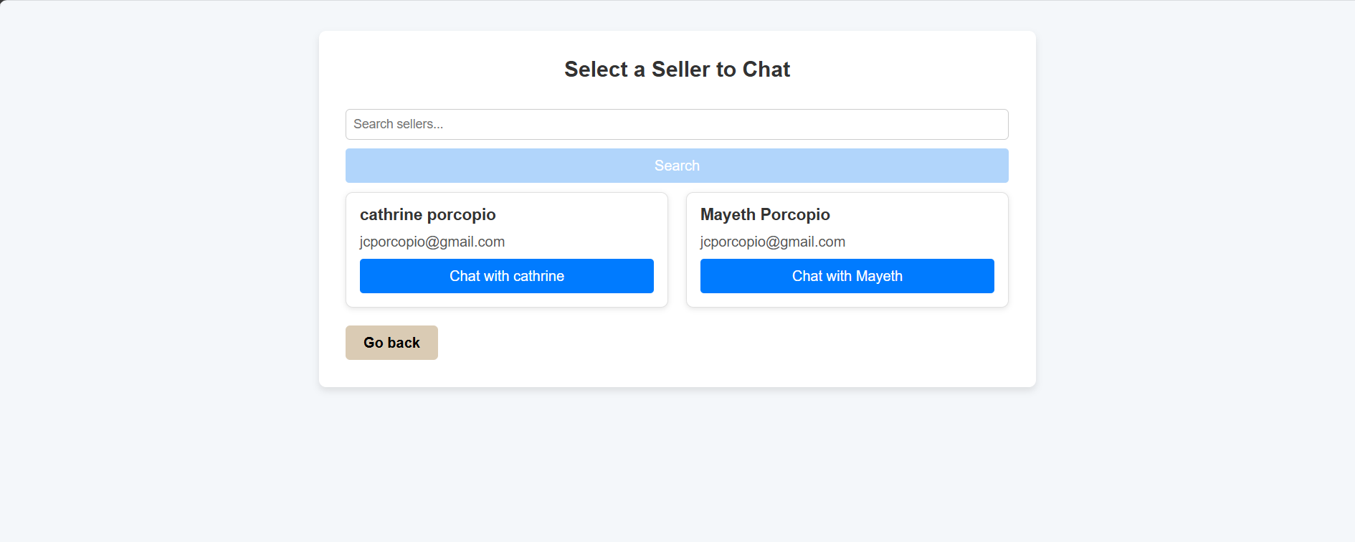
SELLER CHAT
A Seller Chart visually represents the performance and activity of sellers on a platform. It can display data such as sales volume, revenue, or the number of products sold over time. This chart helps admins and sellers track growth trends, identify top performers, and make informed business decisions. By analyzing the Seller Chart, stakeholders can spot patterns, improve strategies, and enhance overall marketplace efficiency.

Slide 19
S E L L E R PA N E L
S E L L E R PA N E L

Slide 20

SELLER LOGIN
The Seller Login system provides a secure way for sellers to access their accounts on the platform. Sellers use their unique Username to identify themselves and a Password to verify their identity. This login process protects sensitive seller information and ensures that only authorized users can manage their products, view sales data, and interact with customers. Strong username and password requirements help maintain account security and prevent unauthorized access.

Slide 21
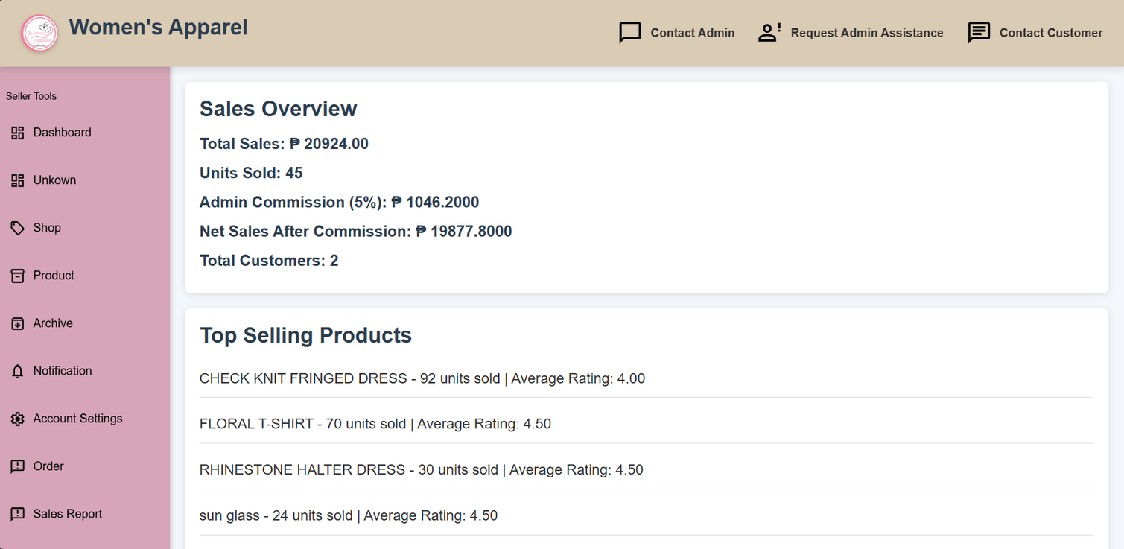
DASHBOARD
The Seller Dashboard provides sellers with a clear overview of their sales performance, including total revenue and sales trends over time. It also features a section for Top Selling Products, which helps sellers identify their most popular items. By reviewing this data, sellers can make smarter decisions about inventory, marketing, and pricing strategies to increase their sales and grow their business effectively.

Slide 22
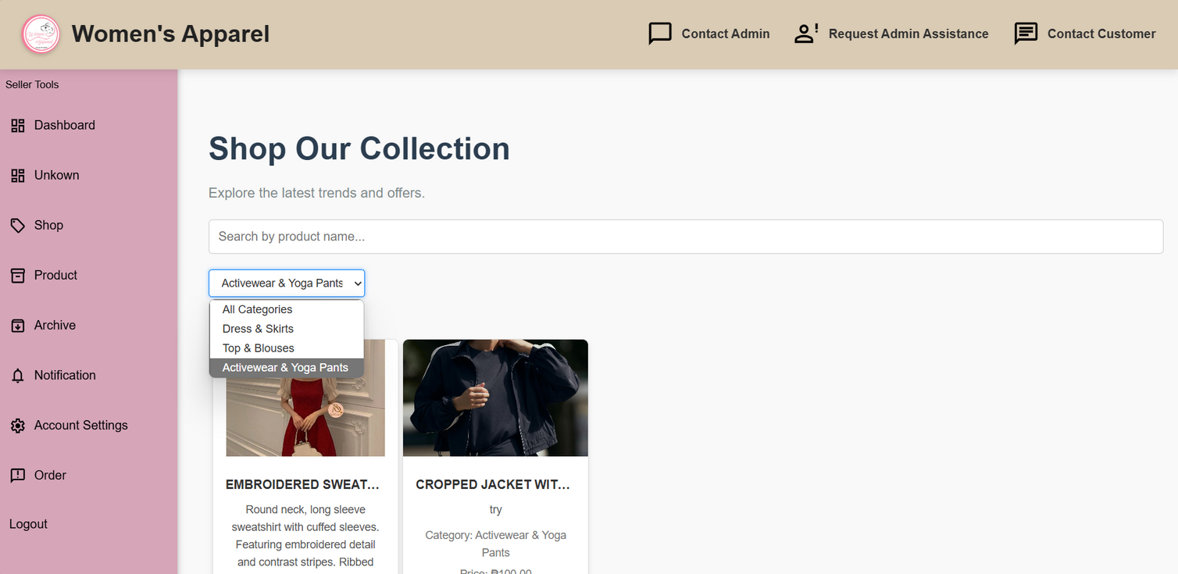
SHOP COLLECTION
The Shop Collection organizes products into themed groups for easy browsing. The Search feature helps users quickly find specific items. Detailed Product Descriptions provide important information to help customers make informed purchases.

Slide 23
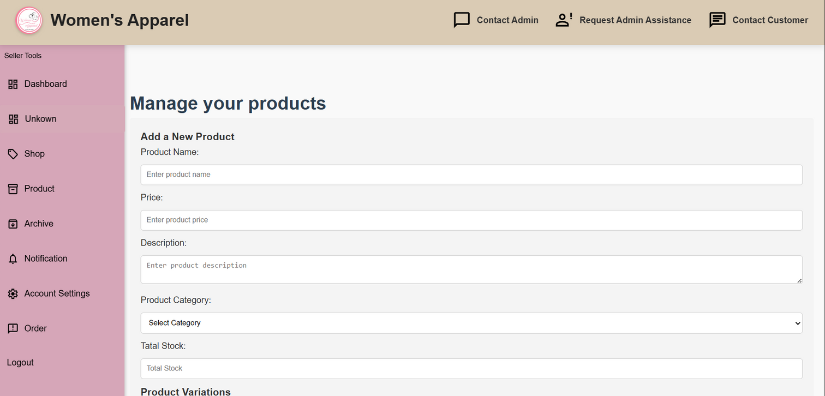
MANAGE PRODUCT
Manage Product refers to the process where sellers or admins oversee all aspects of the products listed on the platform. This includes adding new products, updating existing product details like price, description, and images, and removing items that are no longer available.

Slide 24
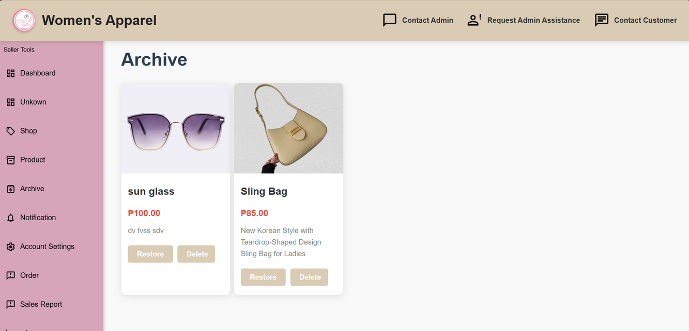
ARCHIVE
Archive is a feature used to store or hide old, inactive, or outdated records such as products, orders, or user data without permanently deleting them. This function helps keep the system organized and clutter-free while still preserving important information for future reference. Archived items can often be restored when needed, making it a useful tool for managing content over time. In a seller or admin system, archiving helps maintain a clean dashboard while keeping historical data accessible for review or reporting.

Slide 25
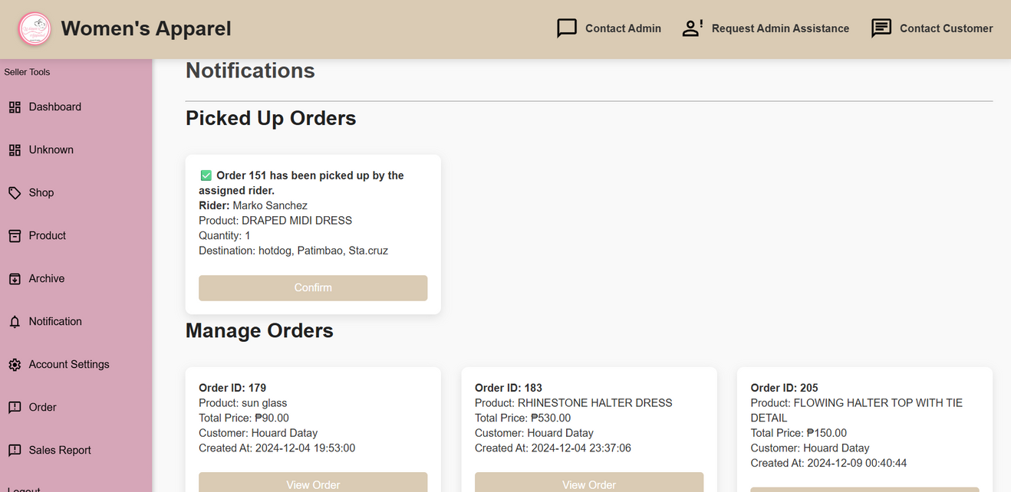
NOTIFICATION
Notifications alert users about important updates, such as new orders, status changes, or messages, helping them stay informed and take timely action. Pick Up Order refers to orders that are ready to be collected by buyers or delivery personnel, ensuring an organized and efficient pickup process. Manage Order allows sellers or admins to monitor and control the full order cycle from confirming purchases to updating statuses and resolving issues ensuring that each order is processed smoothly and delivered on time.

Slide 26
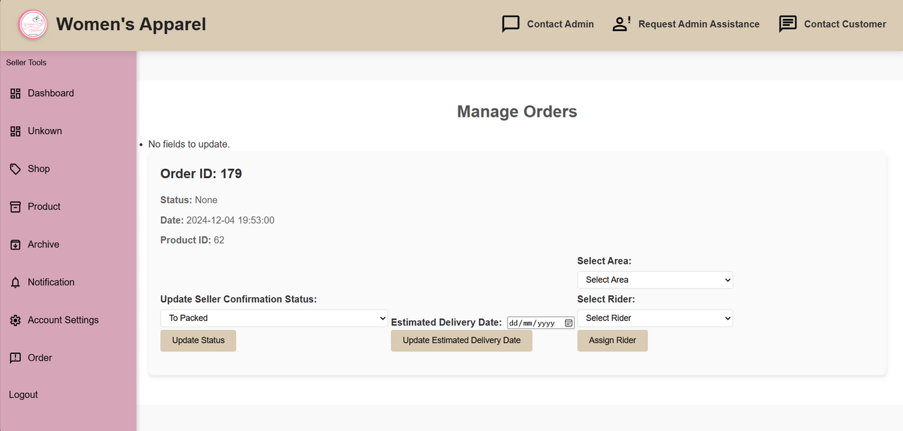
MANAGE ORDER
Manage Order is a crucial feature in any e-commerce or business platform that allows sellers or administrators to oversee and handle the complete order process. This includes viewing all incoming orders, updating order statuses (such as pending, processing, shipped, or delivered), and managing returns or cancellations if needed.

Slide 27
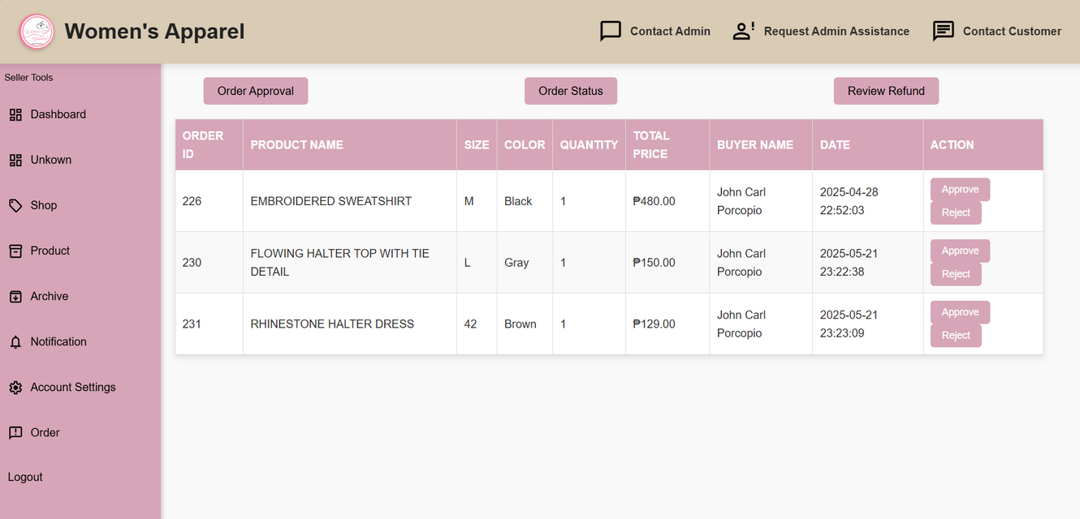
ORDER APPROVAL
Order Approval is the process where sellers or administrators review and verify orders before they are officially processed. This step helps ensure that all details such as product availability, pricing, and customer information are correct. It reduces the risk of errors, fraud, or stock issues. By carefully approving each order, businesses can maintain smooth operations, provide better service to customers, and ensure that only valid and ready-to-ship orders move forward in the system.

Slide 28
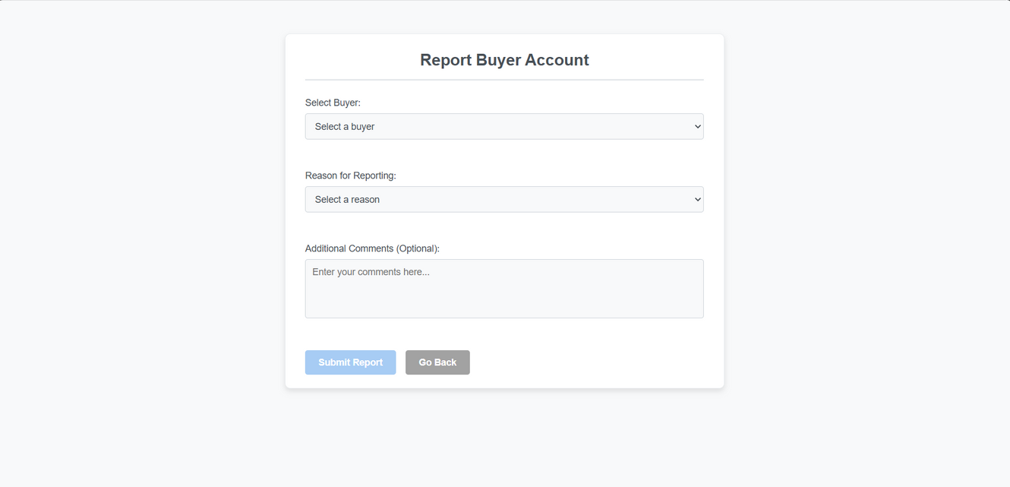
REPORT BUYER ACC
Report Buyer Account is a feature that lets sellers or administrators flag buyer accounts for suspicious behavior, fraud, policy violations, or abusive actions. This system helps protect the marketplace by ensuring that all users follow the rules and maintain respectful interactions. Reported accounts are reviewed by support teams who take necessary actions, such as warnings or suspensions, to keep the platform safe and fair for everyone involved.

Slide 29
MOBILE VERSION
Discover the latest trends in women's fashion — from everyday wear to elegant styles. Explore our wide selection of clothing, accessories, and footwear designed to make every woman feel confident, comfortable, and stylish.
CLICK HERE
CLICK HERE

Slide 30
B U Y E R M O B I L E
B U Y E R M O B I L E

Slide 31
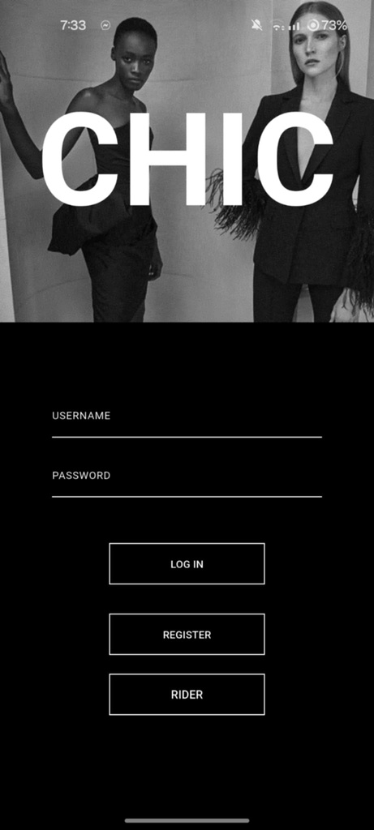
LOG IN
Mobile Login is a feature that allows users to access their accounts easily through their mobile devices like smartphones and tablets. It offers various secure ways to log in, including entering a username and password

Slide 32
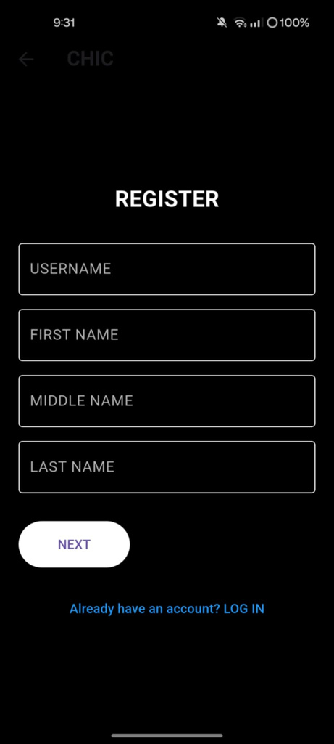
REGISTRATION
Registration is the process where new users create an account by providing personal information. It often includes verification steps to ensure authenticity, helping secure the platform and encourage user participation.

Slide 33
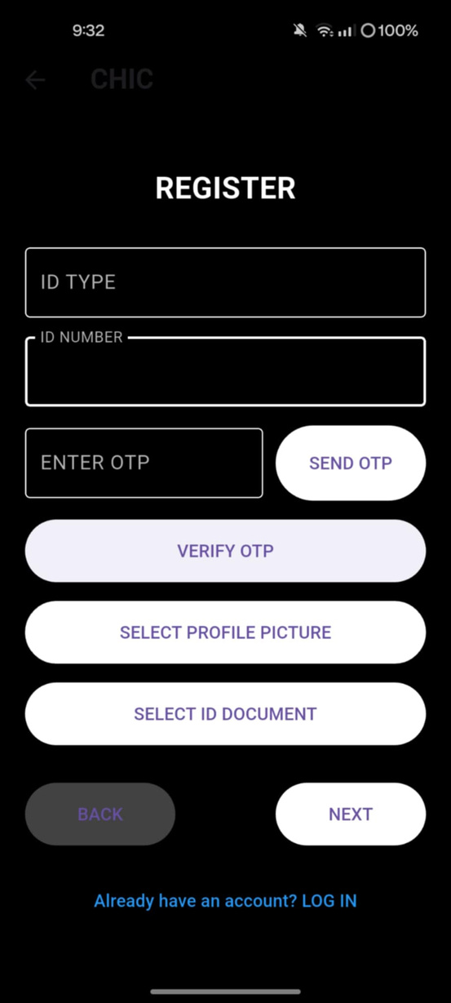
REGISTRATION
Registration OTP (One-Time Password) is a security feature used during the user registration process to verify the authenticity of the user’s contact information, typically their mobile number or email address. When a user signs up, the system sends a unique, time-sensitive code (OTP) to the provided contact method. The user must enter this code to complete their registration.

Slide 34
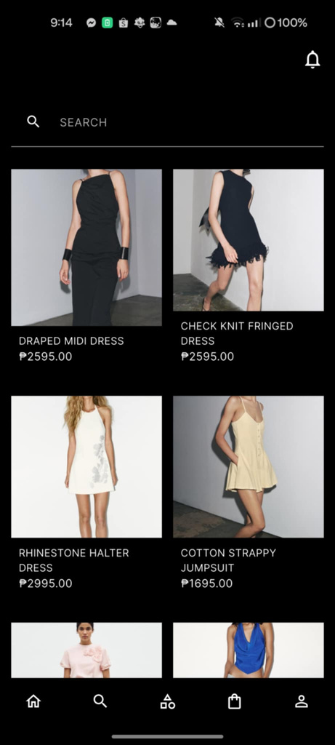
SEARCH BAR
Search is a fundamental feature in any digital platform that allows users to quickly find specific information, products, or content by typing keywords or phrases. It enhances user experience by making navigation easier and more efficient, especially when dealing with large amounts of data or extensive product

Slide 35
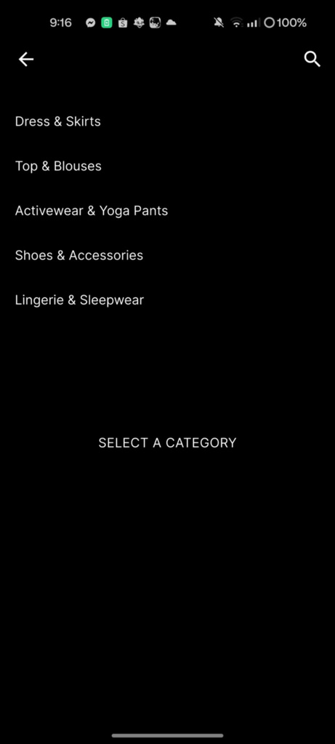
SELECT CATEGORY
Select Category is a feature that allows users to filter and browse products or content based on predefined groups or classifications. By choosing a specific category, users can narrow down their search and quickly find items that match their interests or needs.

Slide 36
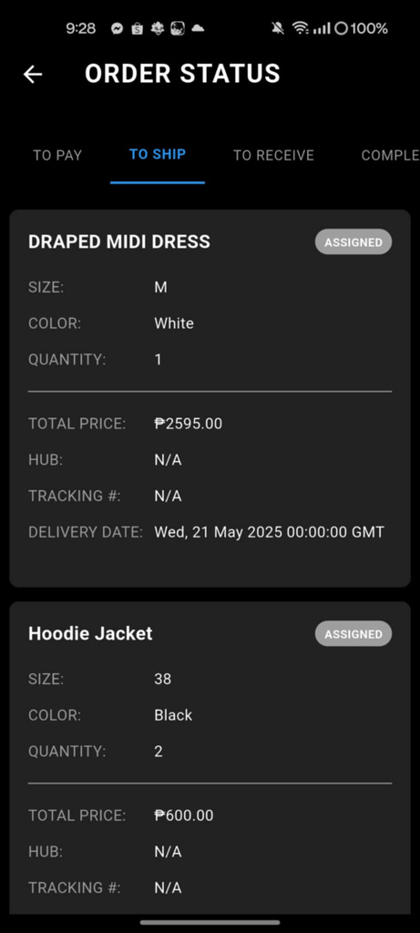
ORDER STATUS
Order Status refers to the different stages that an order goes through from the moment it is placed until it is completed or canceled. Common statuses include “Pending,” “To Pay,” “To Ship,” “To Receive,” “Completed,” “Refunded,” and “Canceled.” These status updates help both sellers and buyers track the progress of an order in real time.

Slide 37
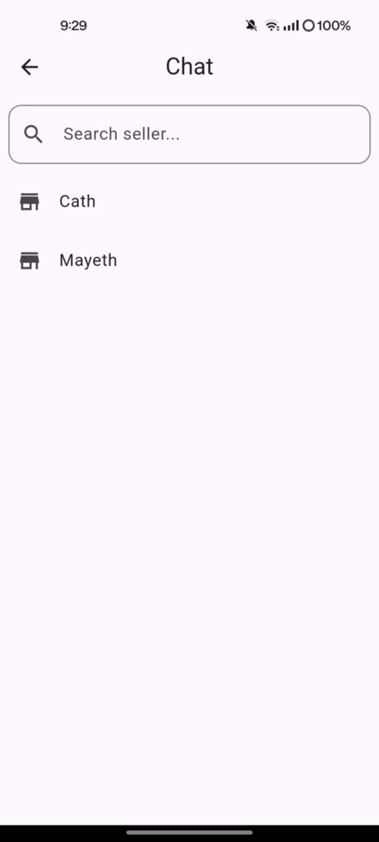
CHAT
Chat is a real-time communication feature that enables users, such as buyers and sellers, to exchange messages instantly within a platform. This functionality enhances customer service by allowing quick clarification of questions, negotiation of details, and resolution of issues without the need for external communication tools.

Slide 38
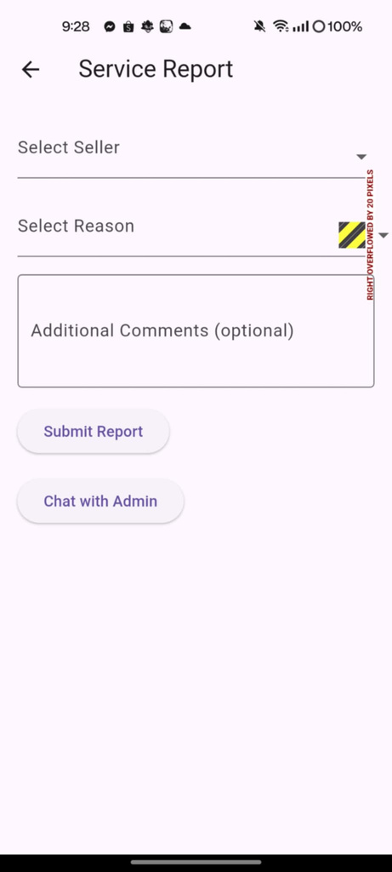
SERVICE REPORT
Service Report is a detailed record or summary of services provided, typically used to track performance, progress, and any issues encountered during the service process. In a business or customer service context, it helps document the work done, the outcomes, and any follow-up actions needed.

Slide 39
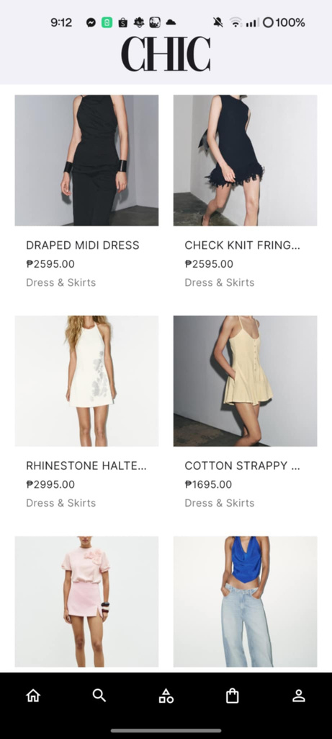
PRODUCT
A Product is any item or service offered by a business for sale to customers. In an online shopping platform, products are the core elements that users browse, select, and purchase. Each product typically includes important details such as its name, description, price, category, and images, helping customers make informed decisions.

Slide 40
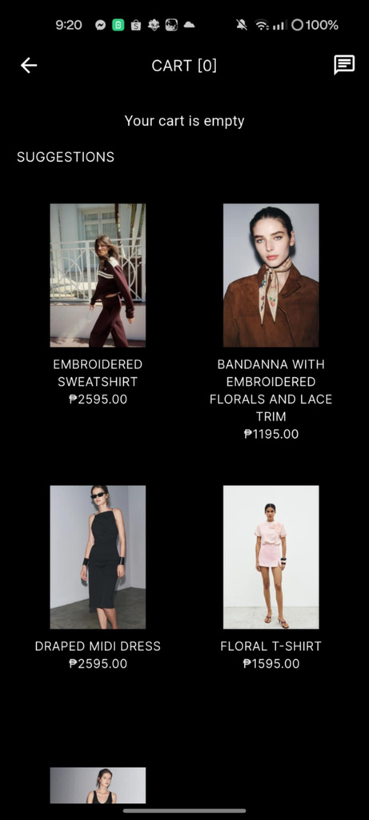
CART
A Cart is a virtual space on an e-commerce platform where users can temporarily store products they intend to purchase. It functions similarly to a physical shopping cart in a store, allowing customers to add, review, and modify selected items before proceeding to checkout.

Slide 41
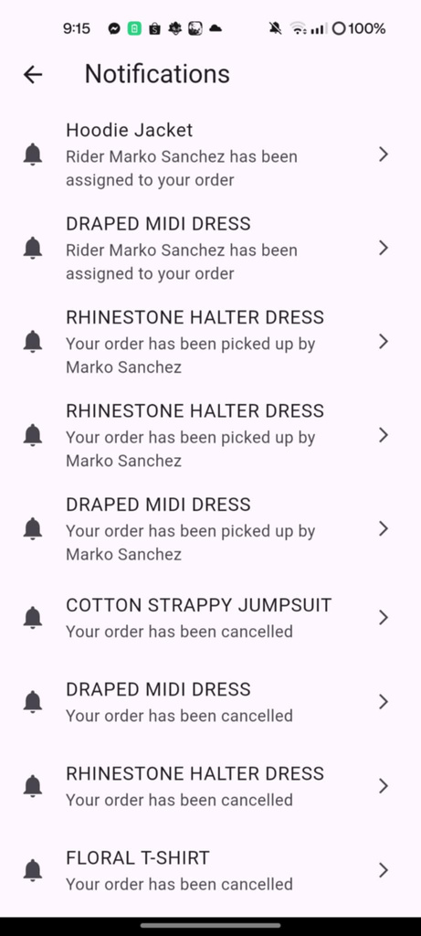
NOTIFICATION
Notification is a feature that alerts users about important updates, actions, or events related to their account or activities on a platform. Notifications can inform users about new messages, order statuses, promotions, or system alerts. They serve as a direct communication channel between the platform and its users, ensuring timely information delivery.

Slide 42
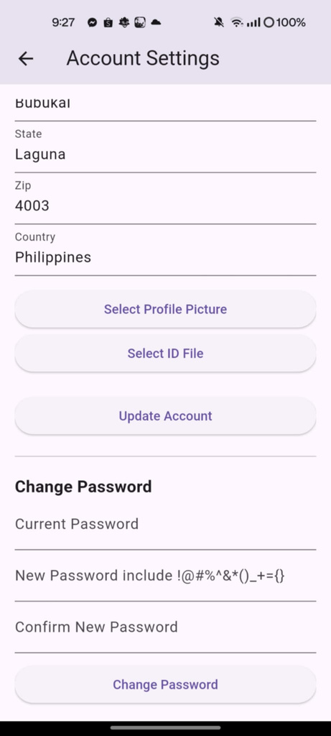
ACCOUNT SETTING
Account Setting refers to the section within a platform or application where users can manage and customize their personal information and preferences. This area typically allows users to update details such as their username, first name, middle name, last name, email address, password, and other profile-related information.

Slide 43
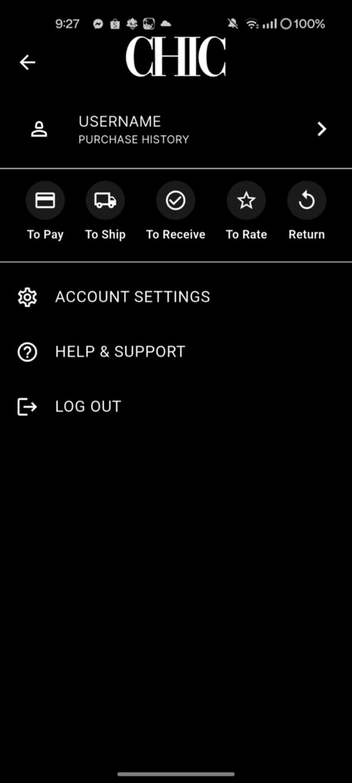
ORDER STATUS
Order Status is a vital feature in e-commerce platforms that informs customers and sellers about the current stage of an order, from the time it is placed until it is completed or canceled. Typical statuses include "To Pay," indicating the payment is pending; "To Ship," meaning the order is ready for dispatch; "To Receive," showing the product is on its way to the customer; "Completed," confirming the successful delivery; "Refund," where the customer is being reimbursed; and "Canceled," indicating the order was terminated.

Slide 44
R I D E R M O B I L E
R I D E R M O B I L E

Slide 45
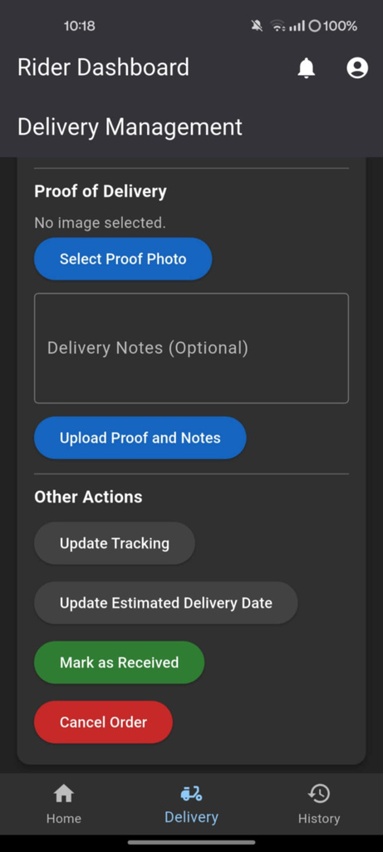
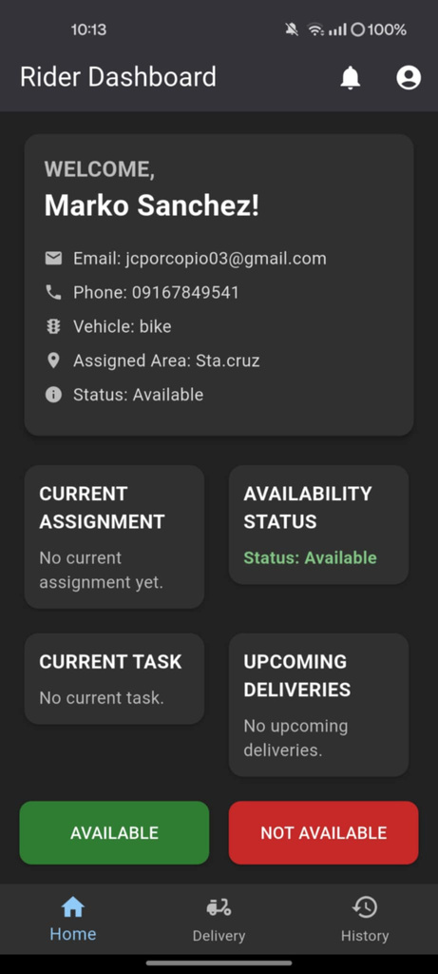
RIDER DASHBOARD
Rider Dashboard is an interface designed specifically for delivery personnel within an e-commerce or delivery platform. It provides riders with a centralized view of their tasks, performance, and important updates. Key features often include a list of assigned delivery orders, status tracking, navigation support, and earnings summary.

Slide 46
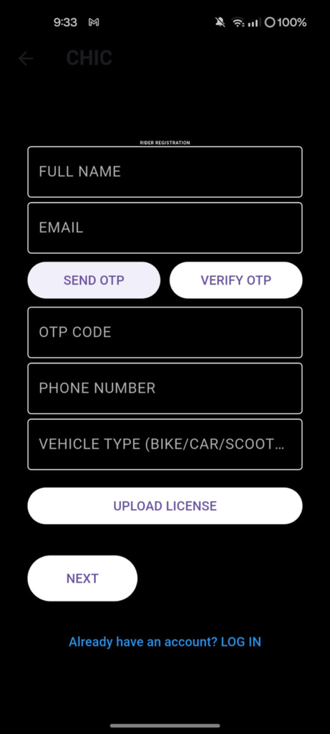
REGISTRATION
Registration is the initial process through which new users create an account on a platform or application. It involves submitting essential personal information such as name, email address, username, and password. Often, registration includes verification steps like email confirmation or entering a One-Time Password (OTP) to ensure the authenticity of the user.

Slide 47
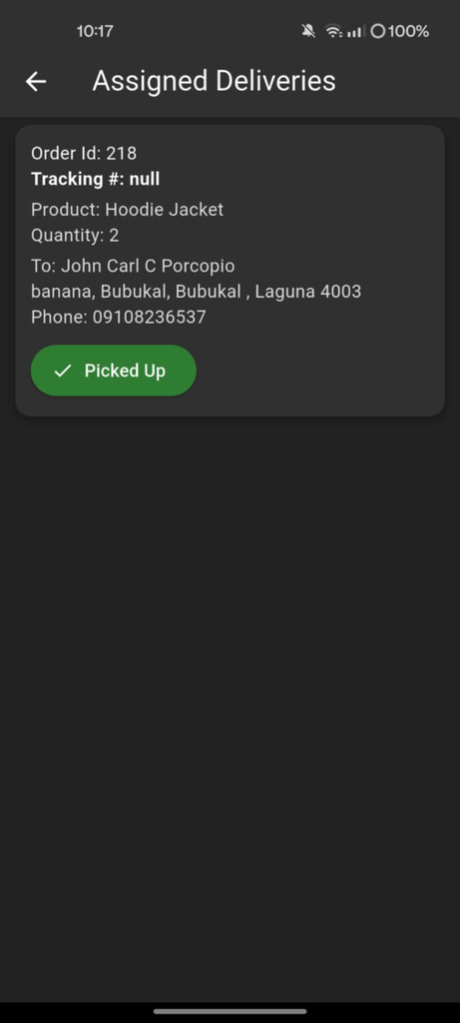
ASSIGNED DELIVERIES
Assigned Deliveries refers to the list or tasks of delivery orders specifically allocated to a rider or delivery personnel within a logistics or e-commerce platform. Once an order is placed and processed, it is assigned to a rider who is responsible for picking up the product from the seller or warehouse and delivering it to the customer.

Slide 48
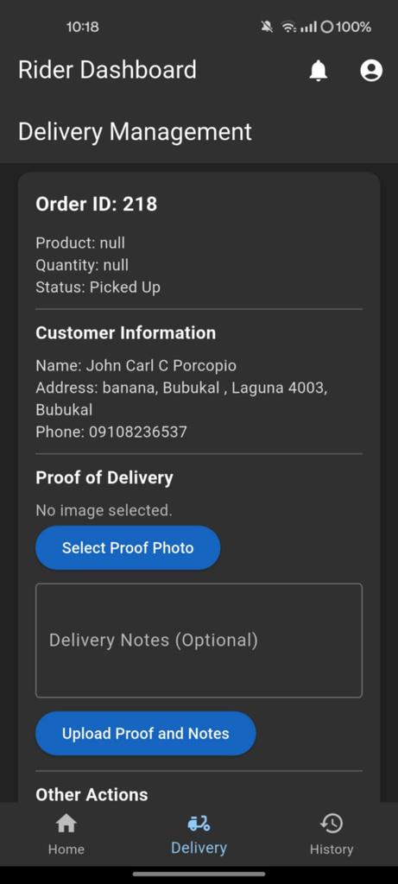
DELIVERY MANAGEMENT
Delivery Management is the systematic process of overseeing and coordinating the entire delivery operation within an e-commerce or logistics platform. It involves planning, assigning, tracking, and completing the transportation of products from sellers or warehouses to customers. This includes managing delivery schedules, rider assignments, route optimization, and handling any issues that may arise during transit.

Slide 49
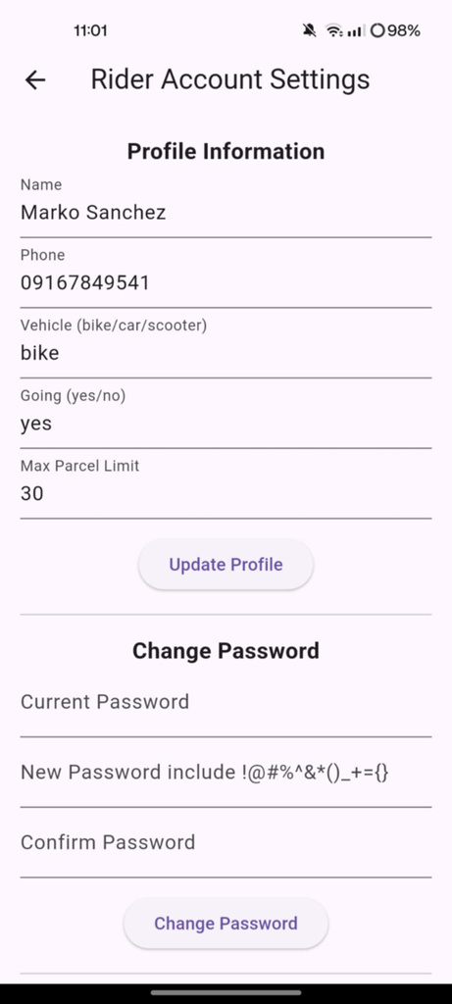
RIDER ACCOUNT SETTING
Rider Account Setting is a dedicated section within a delivery or e-commerce platform where riders (delivery personnel) can manage and update their personal information and account preferences. This includes details such as their username, full name, contact information, password, and possibly vehicle details or availability status.

Slide 50
THANK YOU
THANK YOU

